Slide 1

Getting with ES6 and Rendering with JSX

Slide 2
Objectives
Overview ES6 – ECMAScript 6
Some features of ES6
Overview JSX
JSX Content: Rendering HTML, Describing the UI structure
Creating JSX elements
Using JavaScript expressions
Fragments of JSX

Slide 3

What is ES6?
ES6 (ECMAScript 6) is the latest version of the ECMAScript standard. ECMAScript was proposed by the European Computer Manufacturers Association to serve as the standard for the JavaScript programming language.
Currently, there are several web browsers available, and if each browser were to run JavaScript differently, websites would not be able to function consistently across all these browsers.
Therefore, there is a need for a common standard to ensure that these browsers develop based on these standards.

Slide 4
The history of ECMAScript
1995: LiveScript is born.
1997: The ECMAScript standard is established.
1999: ES3 is released. 2000-2005: XMLHttpRequest, also known as AJAX, gains popularity, leading to the rise of applications like Outlook Web Access (2000) and Oddpost (2002), Gmail (2004), and Google Maps (2005).
2009: ES5 is released (currently the most widely used version) with features like forEach, Object.keys, Object.create (by Douglas Crockford), and JSON standardization.
2015: ES6/ECMAScript 2015 is released.
Notes:
JavaScript was initially developed by Brendan Eich at Netscape Communications in the mid-1990s. It was created to add interactivity to web pages and was originally named "LiveScript." Later, it was renamed to "JavaScript" to leverage the popularity of Java.
Standardization Efforts: As JavaScript gained widespread adoption, there was a need for standardization to ensure its compatibility across different platforms and implementations. This led to the formation of the European Computer Manufacturers Association (ECMA) in 1994, which took up the task of standardizing JavaScript.
ECMAScript 1: In June 1997, the first edition of the ECMAScript standard, officially known as ECMAScript 1, was released. It was based on JavaScript 1.1 and provided the core syntax and semantics of the language.
ECMAScript 2 and 3: ECMAScript 2 was released in June 1998, introducing minor changes and clarifications. ECMAScript 3, released in December 1999, brought significant improvements to the language, including regular expressions, try/catch exception handling, and more. ECMAScript 4 (Abandoned): Work began on ECMAScript 4 with ambitious plans for major language enhancements. However, due to disagreements and concerns about backward compatibility, ECMAScript 4 was eventually abandoned. ECMAScript 5: In December 2009, ECMAScript 5 was released, providing substantial updates to the language. It introduced features such as strict mode, JSON support, array methods (e.g., forEach, map, reduce), and improved property handling. ECMAScript 6 (ES6) and Beyond: ECMAScript 6, released in June 2015, brought significant changes and introduced many new features, such as arrow functions, classes, modules, promises, and enhanced syntax. Since then, ECMAScript has adopted a yearly release cycle, introducing new features and improvements with each version.

Slide 5
Some features of ES6
Arrow Functions
Template Literals
Destructuring Assignment
Classes
Modules
Enhanced Array Manipulation
Promises
Enhanced Object Manipulation
Default Parameters
Rest and Spread Operators
Notes:
Arrow Functions: Arrow functions provide a more concise syntax for writing functions, with implicit return and lexical scoping of this. They are especially useful for writing shorter and cleaner code.
Template Literals: Template literals allow for more flexible string interpolation and multiline strings. They support embedded expressions and can be used to create dynamic and readable strings.
Destructuring Assignment: Destructuring assignment allows for extracting values from arrays or objects into individual variables. It simplifies the process of accessing and working with complex data structures.
Classes: ES6 introduces class syntax, making it easier to work with object-oriented programming (OOP) patterns in JavaScript. Classes provide a more familiar and structured way to define objects and their behavior.
Modules: ES6 introduces a standardized module system using the import and export keywords. Modules allow for better code organization, encapsulation, and reusability, promoting a modular development approach.
Enhanced Array Manipulation: ES6 enhances array manipulation with features like the map, filter, reduce, and find methods. These methods provide more expressive ways to work with arrays, reducing the need for traditional for loops.
Promises: Promises provide a standardized way to handle asynchronous operations. They simplify asynchronous code flows, making it easier to handle complex scenarios like chaining multiple asynchronous operations or handling errors.
Enhanced Object Manipulation: ES6 introduces features like object shorthand notation, computed property names, and object destructuring, making object manipulation more concise and flexible.
Default Parameters: Default parameter values allow for specifying default values for function parameters. When a parameter is not explicitly passed, its default value is used instead.
Rest and Spread Operators: The rest (...) and spread (...) operators provide convenient ways to work with variadic function parameters, arrays, and objects. The rest operator allows for gathering remaining arguments into an array, while the spread operator allows for unpacking elements from arrays or objects.

Slide 6
Arrow functions
This syntaxs provide a shorter and more expressive way to define functions compared to traditional function expressions.
Syntax:
Arrow functions have a simplified syntax with the following structure:
(parameter1, parameter2, ..., parameterN) => {
// function body
}
or
(parameter1, parameter2, ..., parameterN) => expression

Slide 7
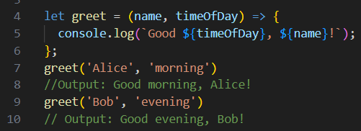

Arrow functions - 2
Arrow function with multiple parameters

Slide 8
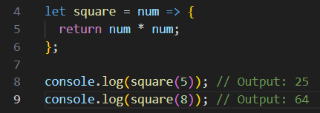

Arrow functions - 3
Arrow function with a single parameter

Slide 9
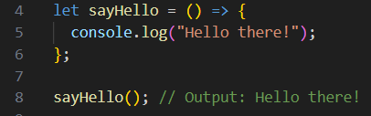
Arrow functions - 4
Arrow function without any parameters

Slide 10
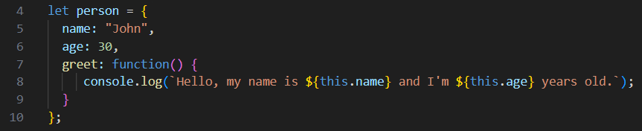
Arrow functions - 5
Arrow functions within object literals

Slide 11
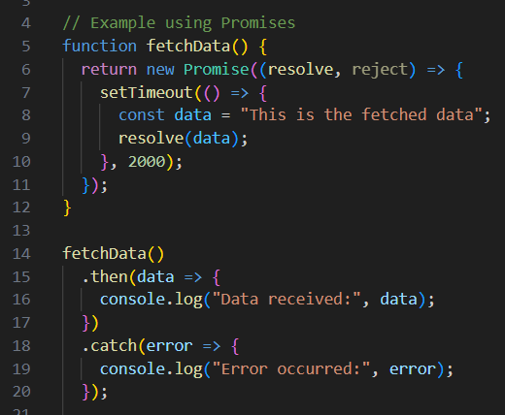
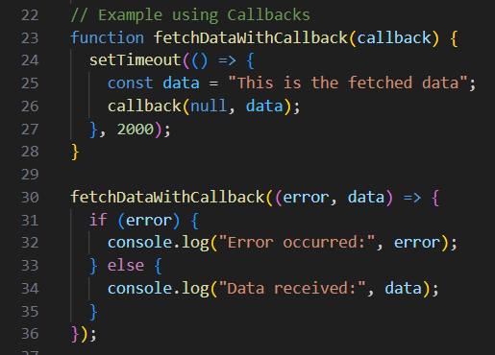
Arrow functions - 6
Use Promises and callbacks

Slide 12
Block-scoped constructs let and const
This is one of the features defined with the keywords let and const. Variables only exist within the block scope of the Block Scope. These blocks are defined using curly braces.
In ES6, let is used to limit the scope of variables within the executing block. With the const keyword, it is an immutable variable and is usually limited to the scope of blocks, similar to let.

Slide 13
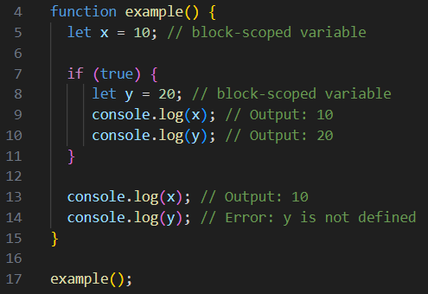
let
The let keyword uses to declare variables with block scope. They are not accessible outside of that block.

Slide 14
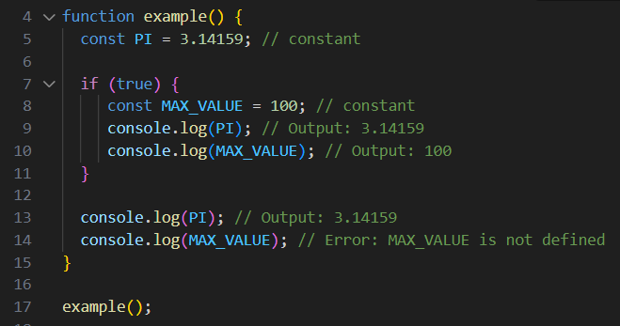
const
The const keyword uses to declare constants with block scope. Constants, as the name implies, are variables that cannot be reassigned after they are defined.

Slide 15
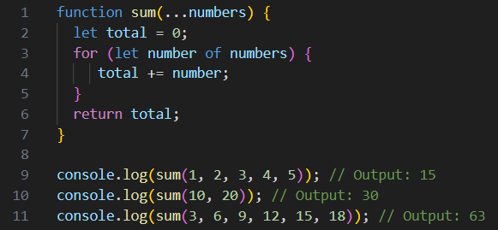
Rest parameter
Rest parameter allows a function to accept an indefinite number of arguments as an array. It is denoted by the ellipsis (...) followed by a parameter name. The rest parameter gathers all the remaining arguments passed to a function into an array, providing a convenient way to work with variable-length argument lists.

Slide 16
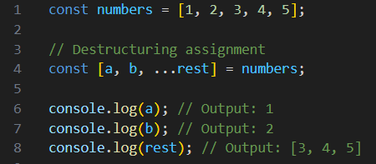
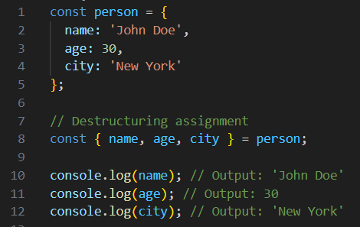
Destructuring assignment
Destructuring assignment allows you to extract values from arrays or objects and assign them to variables in a concise and structured way. It provides a convenient syntax for unpacking values from data structures.
Array Destructuring
Object Destructuring

Slide 17
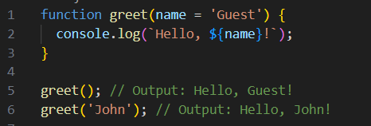
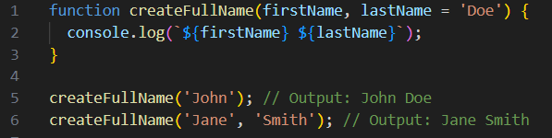
Default parameters
Default parameters allow assign default values to function parameters. If a parameter is not provided or is explicitly set to undefined, the default value will be used instead.
Default parameters can also depend on the values of other parameters.

Slide 18
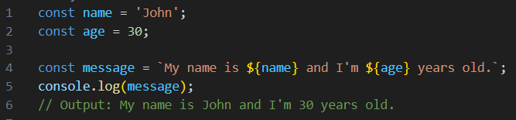
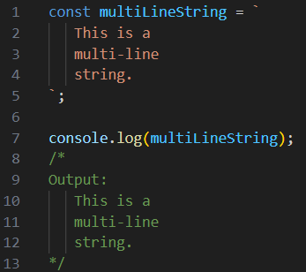
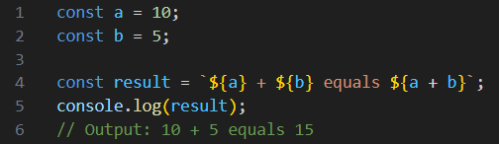
Template literals or template strings
Template literals are an enhanced syntax for creating strings in JavaScript, provide a more expressive and flexible way to work with strings.
Include:
Basic template literal
Multi-line template literal
Expression evaluation in template literals

Slide 19
Promises
Promises handle asynchronous operations in JavaScript.
A promise represents the eventual completion or failure of an asynchronous operation and allows you to write code that can handle the result of that operation asynchronously.
Include:
Creating a Promise
Handling Promises
Chaining Promises

Slide 20
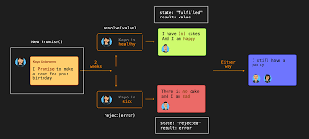
Promises (cont’d)

Slide 21
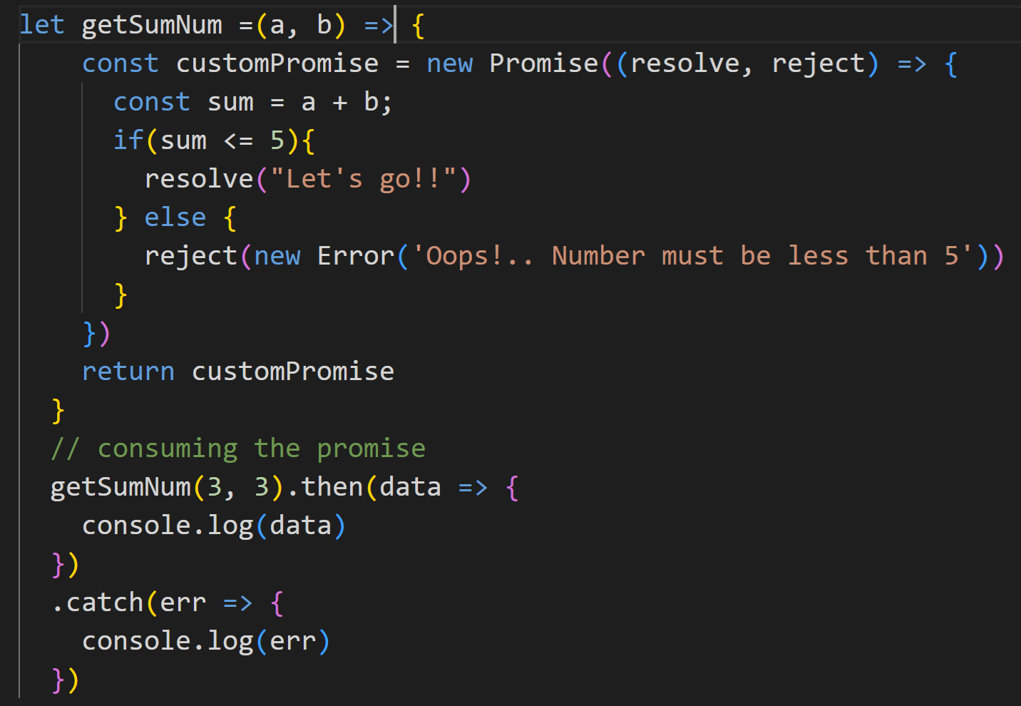
Promises (cont’d)

Slide 22
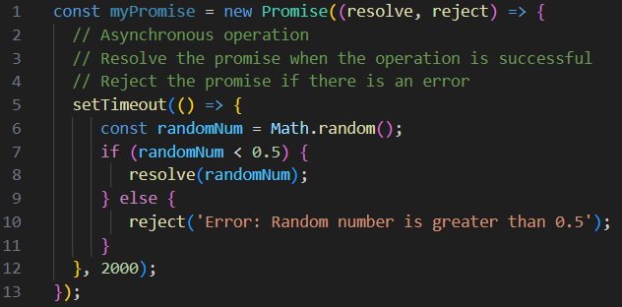
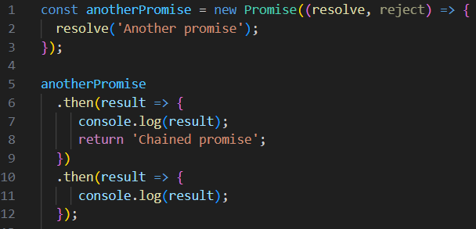
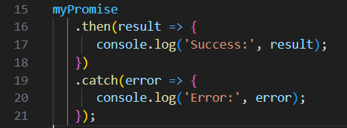
Promises - cont’d
Creating a Promise
Handling Promises
Chaining Promises

Slide 23
Promises - cont’d
Promise.all allows you to handle multiple Promises at once and waits for all of them to complete before proceeding, for multiple asynchronous tasks to complete.
Note that, if any promise from the array is rejected, Promise.all will also be rejected with the reason of the first rejected promise.
let promise1 = new Promise((resolve, reject) => {
setTimeout(() => {
resolve("Promise 1 resolved");
}, 2000);
});
let promise2 = new Promise((resolve, reject) => {
setTimeout(() => {
resolve("Promise 2 resolved");
}, 1000);
});
Promise.all([promise1, promise2]).then((values) => {
console.log(values); // Result: ["Promise 1 resolved", "Promise 2 resolved"]
});

Slide 24
Sync vs Async
Synchronous: Tasks are performed sequentially. If a task takes a long time to complete, subsequent tasks will have to wait, causing a "blocking" state.
console.log('Start');
let data = '';
for (let i = 0; i < 100; i++) {
data += i;
}
console.log('Finished with data: '+ data);

Slide 25
Sync vs Async – cont’d
Asynchronous: Tasks can start and complete in any order. Perform tasks without having to wait for subsequent tasks to complete, which improves the performance and responsiveness of your application.
Promise:
Async/Await:
let myPromise = new Promise((resolve, reject) => {
setTimeout(() => {
resolve("Promise resolved");
}, 2000);
});
myPromise.then((value) => {
console.log(value); // Outputs: "Promise resolved"
});
let myPromise = new Promise((resolve, reject) => {
setTimeout(() => {
resolve("Promise resolved");
}, 2000);
});
async function asyncFunction() {
let value = await myPromise;
console.log(value); // Outputs: "Promise resolved"
}
asyncFunction();

Slide 26
Classes
Classes provide a syntactic sugar for creating objects and implementing object-oriented programming (OOP) concepts in JavaScript. Classes provide a way to define blueprints for creating objects with shared properties and methods.
Include:
Class Declaration: Classes are declared using the class keyword followed by the class name.
Creating Objects: To create an object from a class, we use the new keyword followed by the class name and any necessary arguments for the constructor.
Inheritance: Classes support inheritance, allowing you to create a new class based on an existing class.

Slide 27
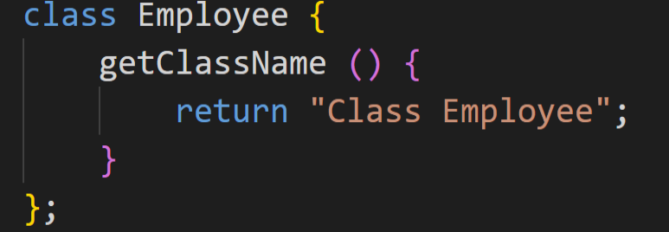
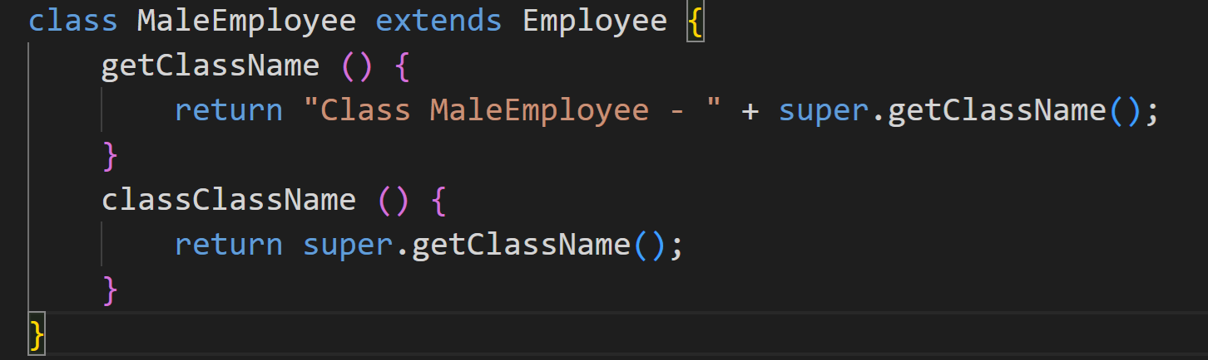

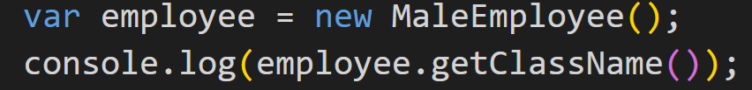
Classes - cont’d
Class Declaration
Inheritance
Creating Objects

Slide 28
What is JSX?

Slide 29
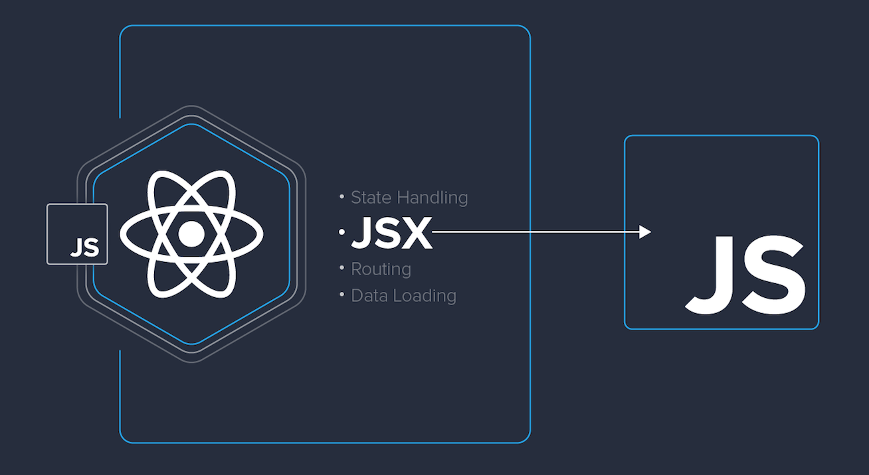
What is JSX?
JSX is the XML/HTML markup syntax that's embedded in JavaScript code and used to declare React components.
JSX is the language used to describe UIs built using React.
In this section, we'll cover the following:
Your first JSX content
Rendering HTML
Describing the UI structure
Creating your own JSX elements
Using JavaScript expressions
Fragments of JSX

Slide 30
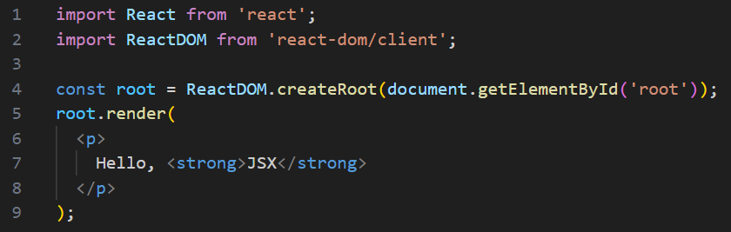
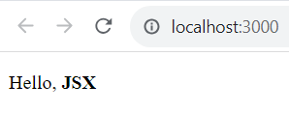
JSX Content: Hello JSX
Your first application:
The render() function takes JSX as an argument and renders it to the DOM node passed to ReactDOM.createRoot().
This example is to show the basic steps involved in getting JSX rendered onto the page

Slide 31
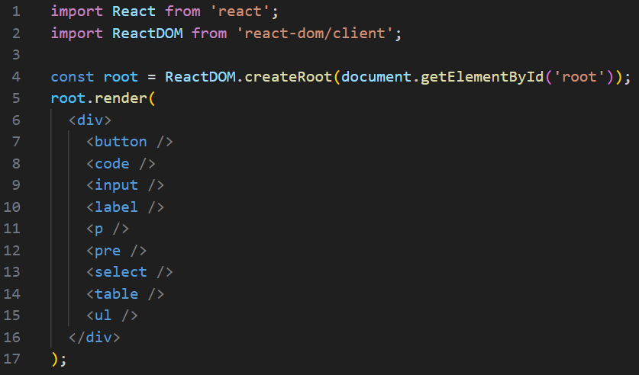
Rendering HTML
Built-in HTML tags
HTML elements rendered using JSX closely follow regular HTML element syntax with a few subtle differences regarding case-sensitivity and attributes.

Slide 32
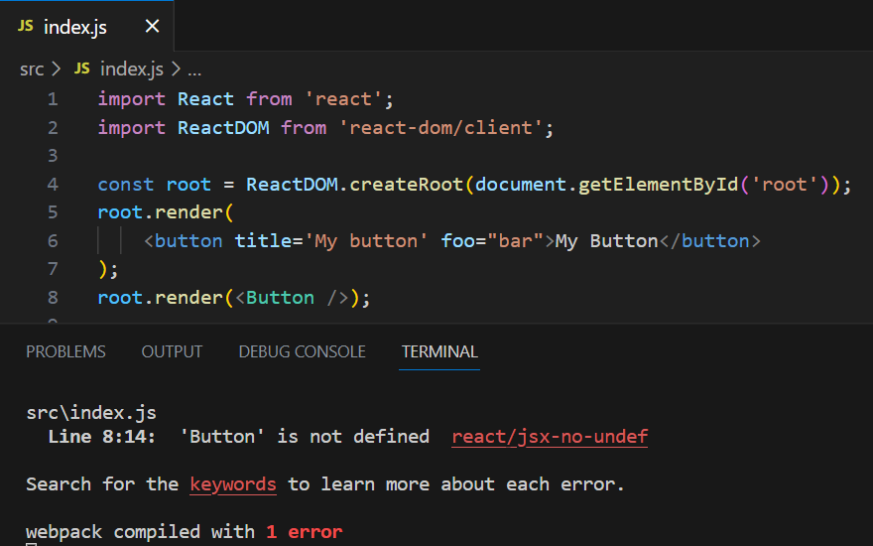
Rendering HTML - cont’d
HTML tag conventions
Tag names are case-sensitive and non-HTML elements are capitalized.
React doesn't know about the <Button> element; it only knows about <button>

Slide 33
JSX Content: Declarative UI structures
The JSX content was short and simple.
It described what to render, not how to render it.
React supports the standard HTML tags that you would find on any HTML page.
React has unique conventions that should be followed when using HTML tags.

Slide 34
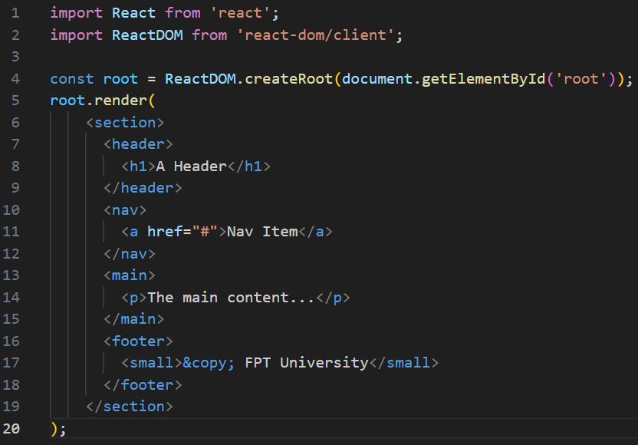
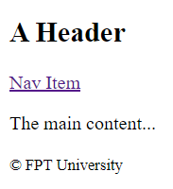
Describing the UI structure – cont’d
This JSX markup describes a fairly sophisticated UI structure.
It's easier to read than imperative code because it's XML, and XML is good for concisely expressing a hierarchical structure

Slide 35
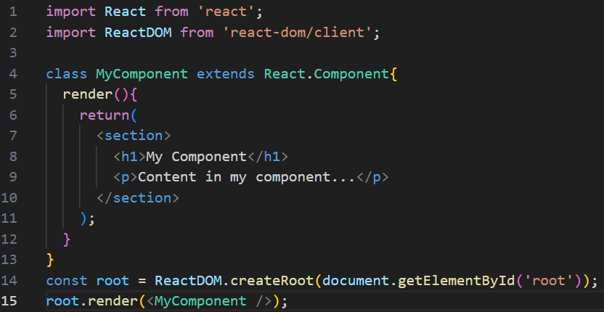

Creating your own JSX elements
Components are the fundamental building blocks of React
Encapsulating HTML:

Slide 36

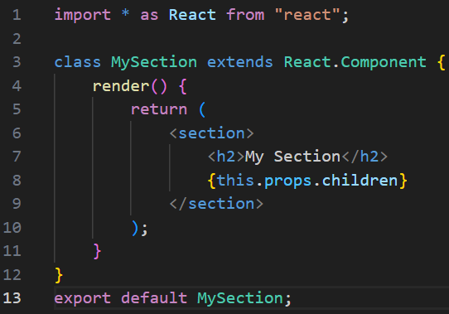
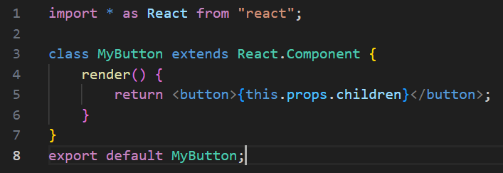
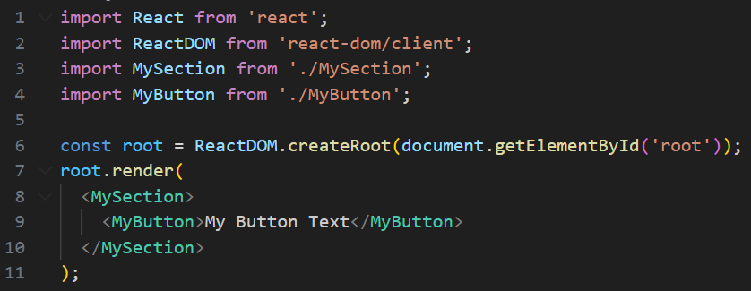

Creating your own JSX elements - cont’d
Nested elements:

Slide 37
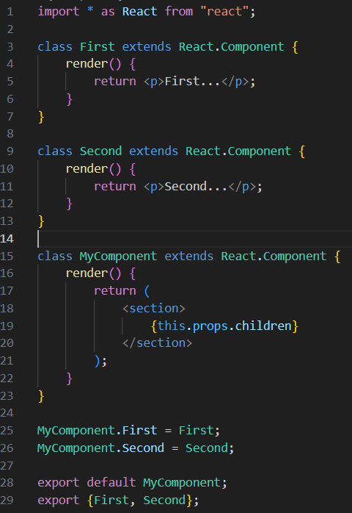
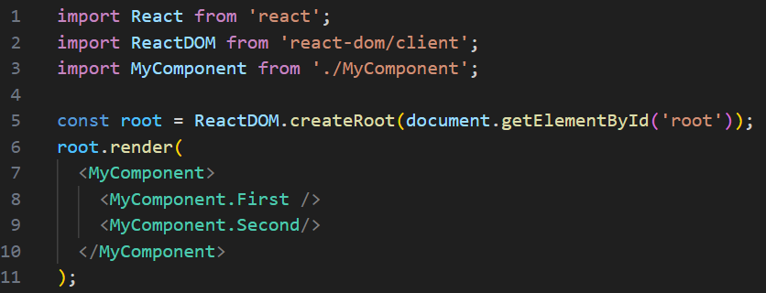
Creating your own JSX elements – cont’d
A namespace provides an organizational unit for your components so that related components can share the same namespace prefix
MyComponent is part of MyNamespace

Slide 38
Exercise 4: Demo about Namespace in JSX

Slide 39
Using JavaScript expressions
How to map collections of data to JSX elements?
Dynamic property values and text
Mapping collections to elements

Slide 40
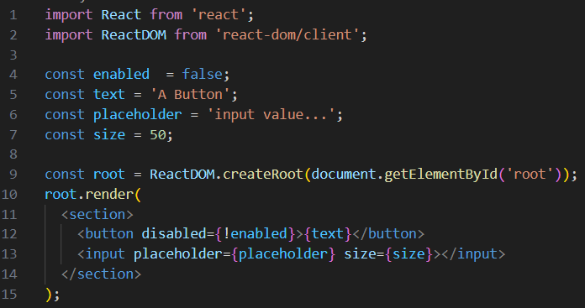
Dynamic property values and text
React is just the view layer.
What the JavaScript expression syntax looks like in JSX markup?
Anything that is a valid JavaScript expression, including nested JSX, can go in between the braces: {}
Primitive JavaScript values are straightforward to use in JSX syntax. But what if you have an object or array that you need to transform into JSX elements?

Slide 41
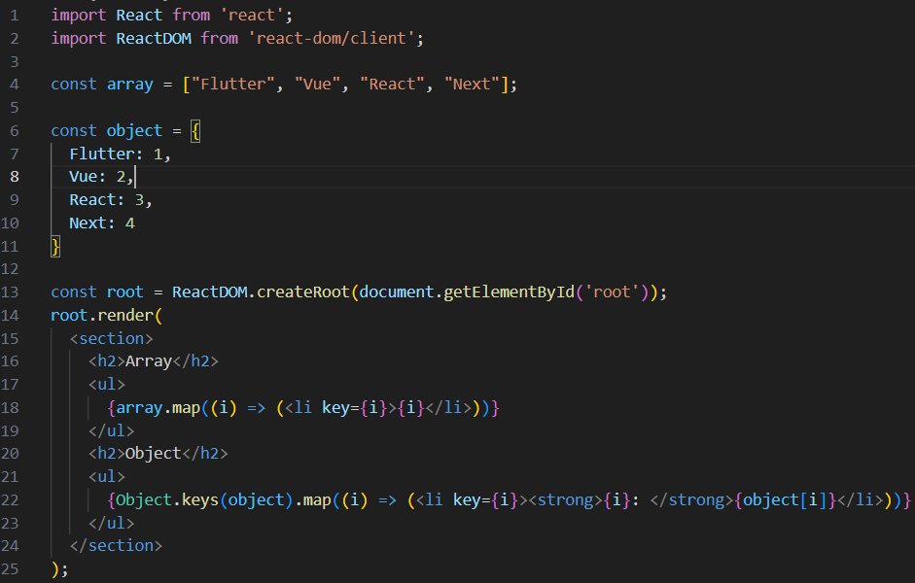
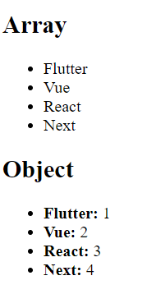
Mapping collections to elements
When you need to add or remove elements based on JavaScript collections?
Using dynamically control JSX elements is to map them from a collection

Slide 42
Fragments of JSX
Fragments are a way to group together chunks of markup without having to add unnecessary structure to your page.
When a component renders a fragment, React knows to render the fragment's child element wherever the component is used

Slide 43
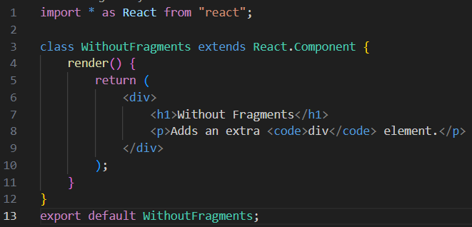
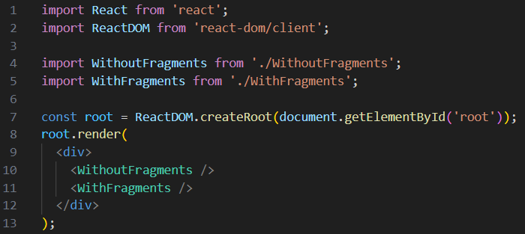
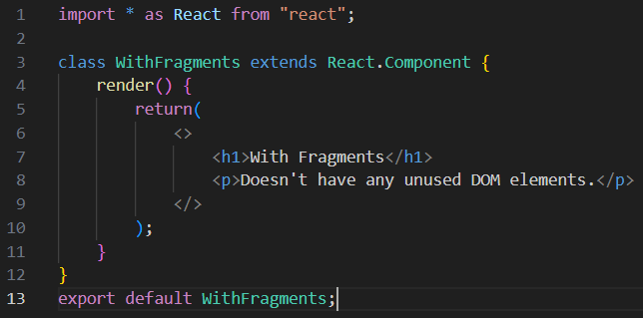
Fragments of JSX – cont’d
Instead of wrapping the component content in <div>, the <> element is used. This is a special type of element that indicates that only its children need to be rendered.

Slide 44
Lab 1: JSX and ES6

Slide 45
Summary
Concepts were introduced:
Overview ES6 – ECMAScript 6
Some features of ES6
Overview JSX
JSX Content: Rendering HTML, Describing the UI structure
Creating JSX elements
Using JavaScript expressions
Fragments of JSX

